Slide 1
3D Jersey Design
19201053 Shariful Islam
21201283 Abu Sayed
24141190 Rizwan Aziz Prince
24141223 Mahmudul Hassan
Group 10

Slide 2
Table of Contents
01
02
Introduction
Implementation
03
04
Result and Visualization
Future Work and Limitation

Slide 3
Introduction
React JS for frontend
Three JS library for 3D Models
Backdrop, shadow and rotation used for better outlook and realistic vibe.
Generative AI for suggestions from the web
We will implement a 3D Jersey where we can add colors, logos, design and ask help from AI

Slide 4
Implementation
Integration of Framer Motion for Animations
Integration with Google Generative AI
Efficient State Management with Valtio
User Feedback and Real-time Updates
Responsive Design and UI Components

Slide 5
Dataset breakdown
Frontend and Backend Technologies
3D Animation with Three JS
Styling with Tailwind CSS
Asset Types for Jersey and Textures
Configuration for Shadows and Lights

Slide 6
Reviewed Codes and Papers
Indoor3D: a WebGL based open source framework for 3D indoor maps visualization. Link
API documentation and software community values: a survey of open-source API documentation. Link
Three JS codes from github. Link
Gemini Pro Chat. Github Link

Slide 7
Result
We got a nice 3D frontend of our jersey with rotation, shadow and backdrop
We can ask AI for suggestions from AI
Changing colors and logo were implemented
We can use the logo as full texture or as logo in the center of the jersey

Slide 8
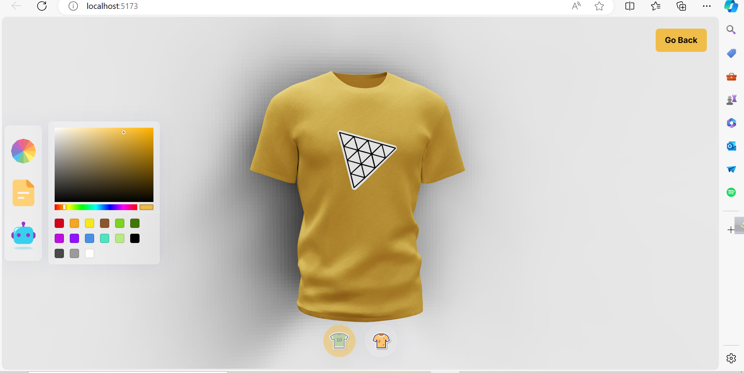
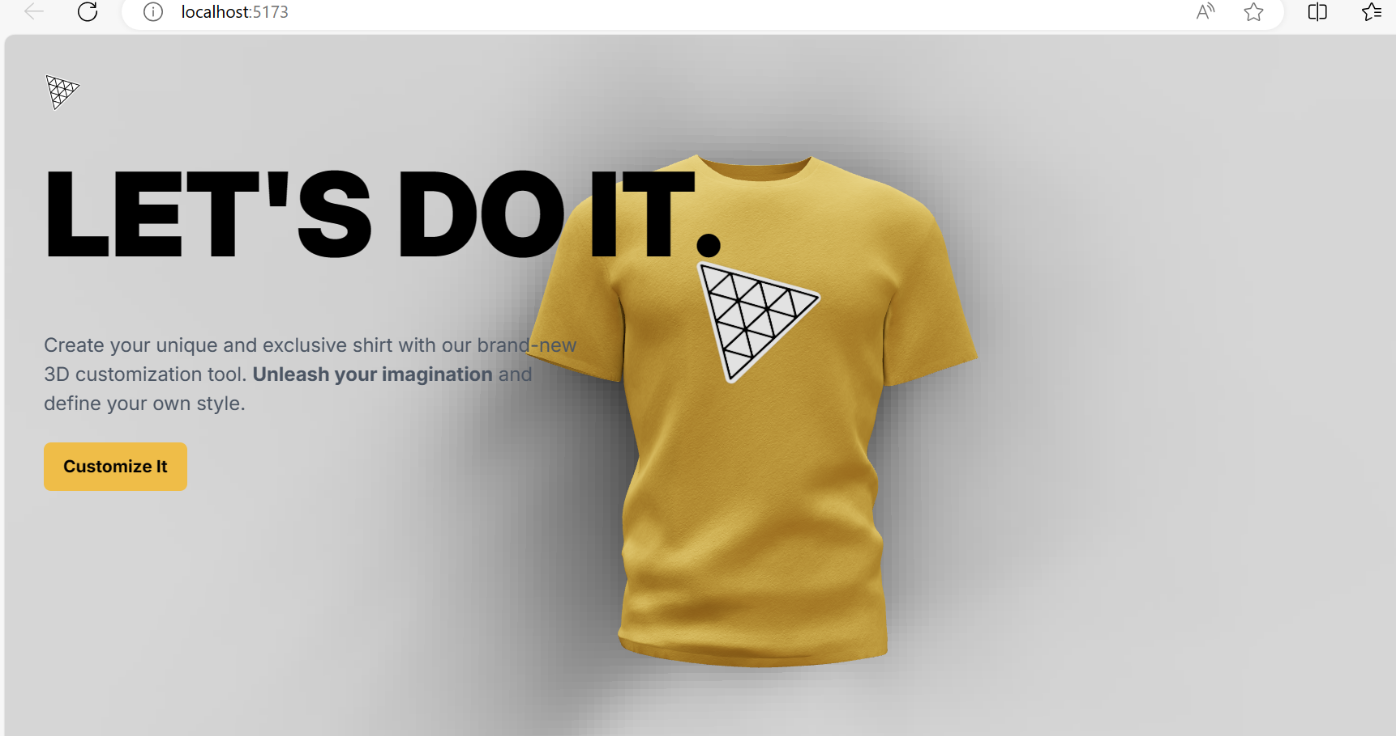
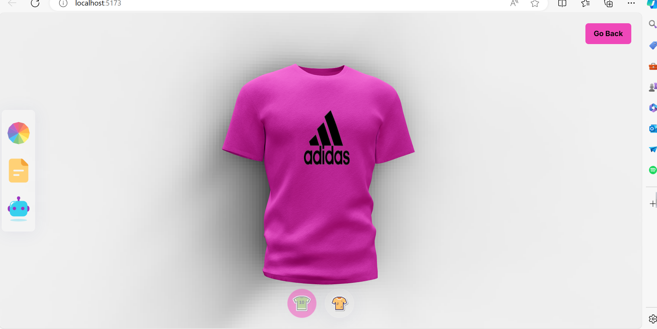
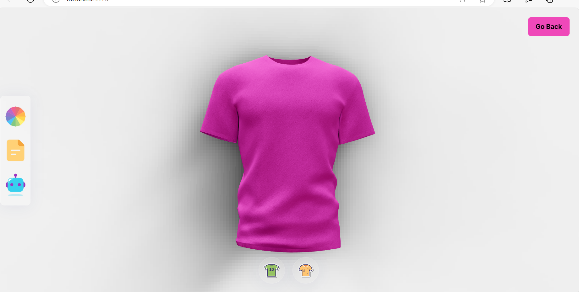
Visualization I

Slide 9
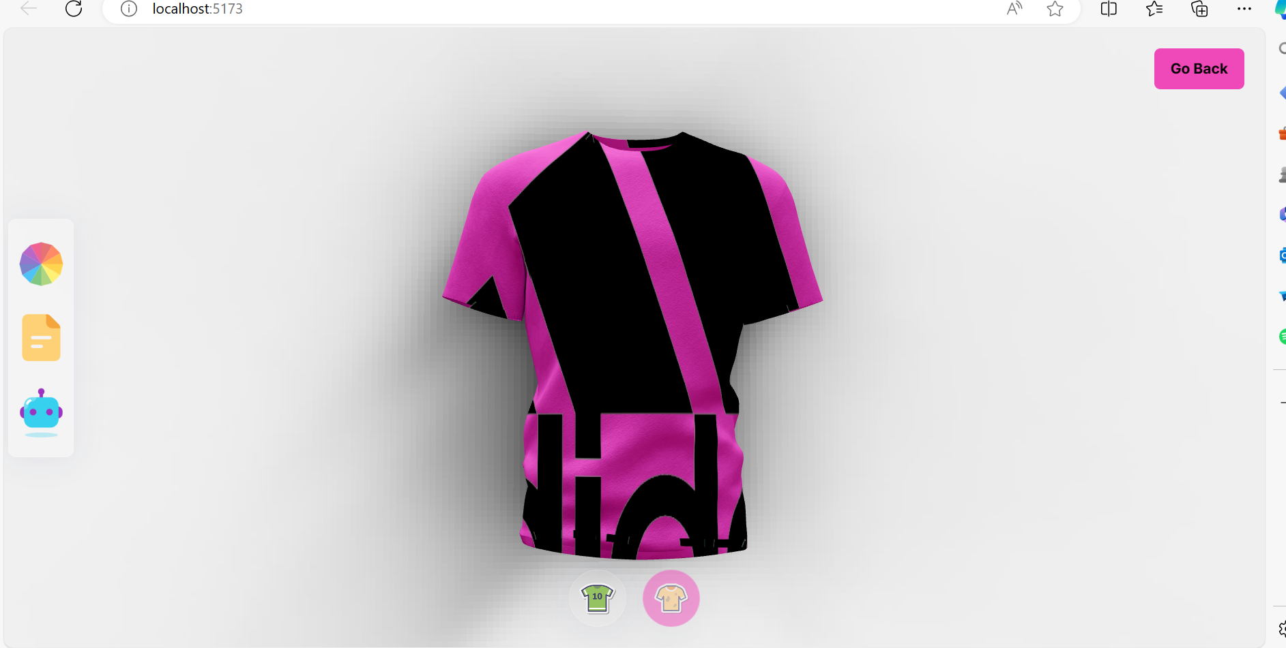
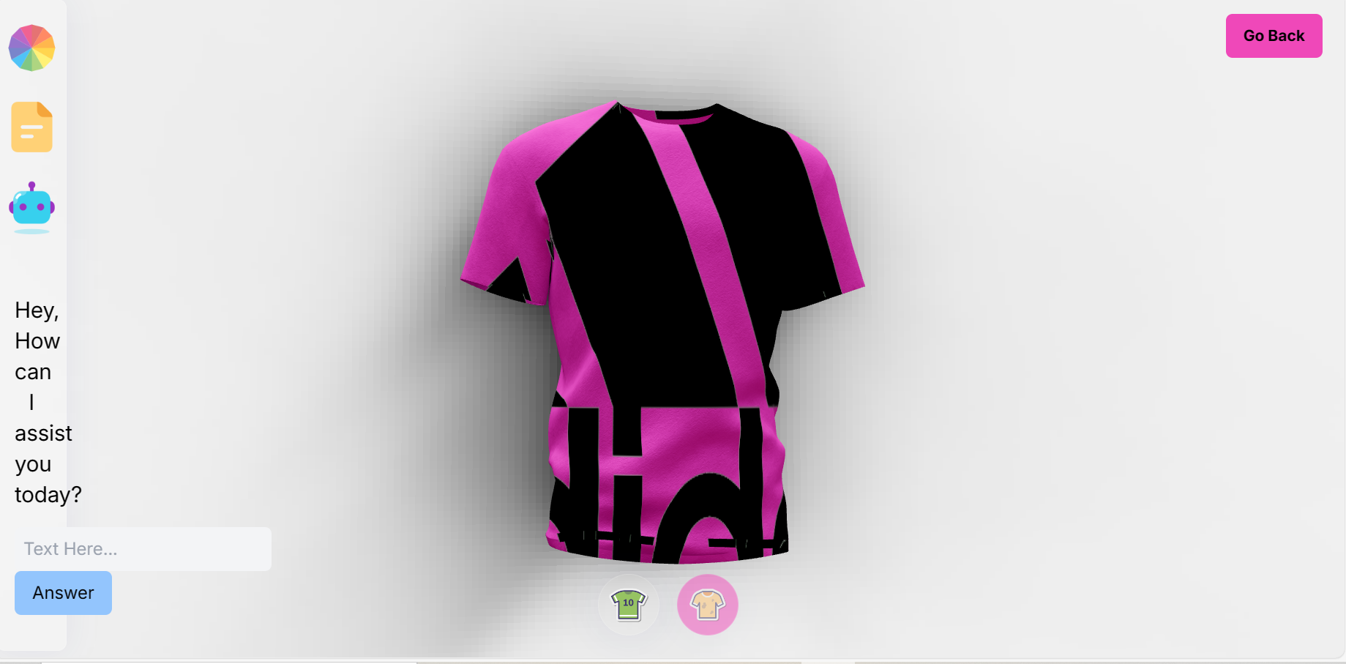
Visualization II

Slide 10
Future Work
Taking logo/design from web with the help of AI.
Adding pant/ shirt/ full sleeve glb files
Enhancing AI response with gpt 4

Slide 11
Limitations
Dalee AI needs gpt 4 which is not free. We would like to extend our work in that and we are sure that we can bring a change in design industry.
Use of different texture jersey and design with more glb file with enhance the validity.

Slide 12
Thank You

